Slide 1
Area Charts
By: Alli Baker, Kelly Murphy & Marina DaCosta

Slide 2
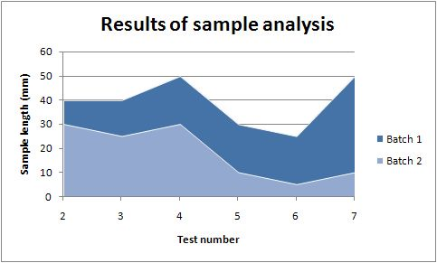
Area Chart
Area charts are used to represent cumulated totals using numbers or percentages over time.
Use the area chart for showing trends over time among related attributes.
The area chart is like the plot chart except that the area below the plotted line is filled in with color to indicate volume.

Slide 3
Area Chart Steps
Set up information in excel in a table format
Go to insert tab, and click area button on the charts.
Select chart type necessary for data.
Click select data in ribbon and highlight data and headings.
Make sure to check if legend entries and horizontal axis labels are correct.

Slide 4
Moving and Formatting Chart
Click move chart under the design tab.
Click new sheet and ok.
To format the chart you can change the chart style or layout under the design tab in the ribbon
To add chart title and axis labels click where it says chart title and axis title.

